Slide 1
Information Security - 2
Topic: Architectural Aid to Secure Systems Engineering
V. Kamakoti
RISE LAB, Department of Computer Science and Engineering
IIT Madras
Session – 4: STACK smashing

Slide 2
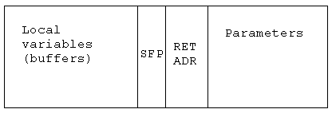
A Stack Frame.
Pushed to stack on function CALL
The return address is copied to the CPU Instruction Pointer when the function returns and it’s stack frame is POP’d.

Slide 3
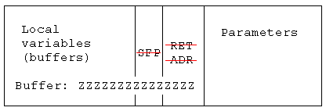
The buffer overflow vulnerability.
The user injected data writes beyond the unchecked buffer length, overwriting the stack frame return address!

Slide 4
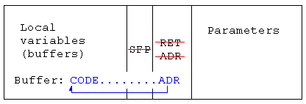
Take control.
The last byte of the buffer is the return address.
To run arbitrary code of the users choice, set to the address of the buffer.

Slide 5
Stack Buffers
Suppose Web server contains this function
void func(char *str) {
char buf[126];
strcpy(buf,str);
}
When this function is invoked, a new frame with local variables is pushed onto the stack
Allocate local buffer
(126 bytes reserved on stack)
Copy argument into local buffer
Stack grows this way
buf
sfp
ret
addr
str
Frame of the
calling function
Top of
stack
Local variables
Pointer to
previous
frame
Execute
code at
this address
after func()
finishes
Arguments

Slide 6
What If Buffer is Overstuffed?
Memory pointed to by str is copied onto stack…
void func(char *str) {
char buf[126];
strcpy(buf,str);
}
If a string longer than 126 bytes is copied into buffer, it will overwrite adjacent stack locations
strcpy does NOT check whether the string
at *str contains fewer than 126 characters
buf
overflow
str
Frame of the
calling function
Top of
stack
This will be
interpreted
as return address!

Slide 7
Executing Attack Code
Suppose buffer contains attacker-created string
  For example, *str contains a string received from the network as input to some network service daemon
code
ret
str
Top of
stack
Frame of the
calling function
Attacker puts actual assembly
instructions into his input string, e.g.,
binary code of execve(“/bin/sh”)
In the overflow, a pointer back
into the buffer appears in
the location where the system
expects to find return address
When function exits, code in the buffer will be
executed, giving attacker a shell
  Root shell if the victim program is setuid root

Slide 8
Spawn a shell.
Write code such that a shell is spawned.
  provides platform independent code to spawn a shell.
Shell command is executed in the program’s security context .
  Allows user impersonation
  If program is running as root, the user now has total control of the host!
  Establish a Virtual Machine based Root Kit (VMBR)
    Learn it in Next Session

Slide 9
End of Session-4
Thank You

